Slide 1
Model Training, Deployment and Serving
Siddhi Bajracharya

Slide 2
Overview
ML Lifecycle
Model Building with Pytorch.
Model Deployment.
Model Serving with Flask API.
Building webapp using Streamlit.

Slide 3
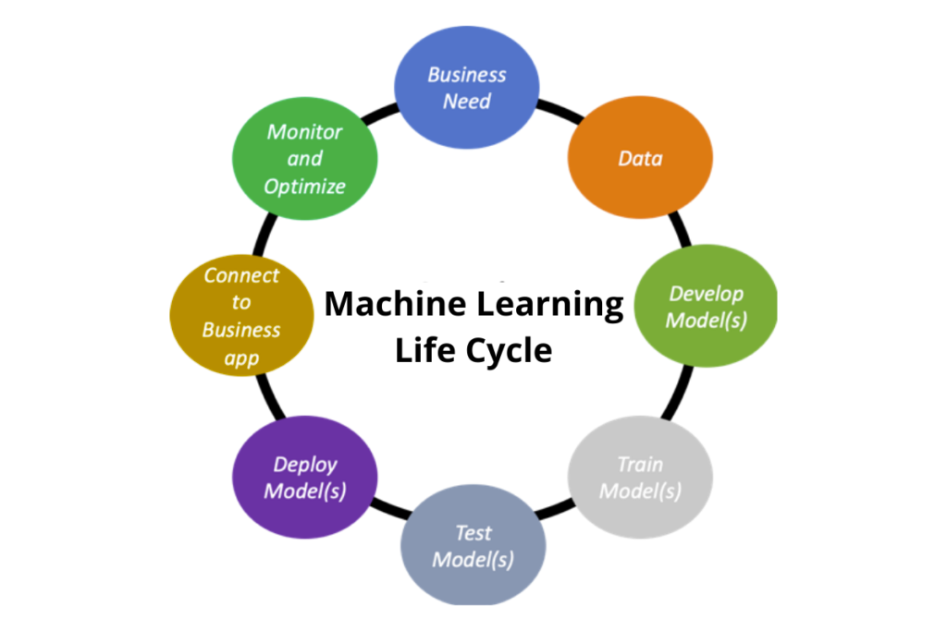
Typical ML Lifecycle
Notes:
https://nearlearn.com/blog/machine-learning-data-science-life-cycle-whats-the-difference/

Slide 4

Model Building and training
Machine Learning framework for computer vision and natural language processing.
Developed by Meta AI in 2016.
Popular in research community.
Large number of pretrained models in hugging face repository.
Alternatives: Tensorflow, scikit-learn, flax
Example

Slide 5
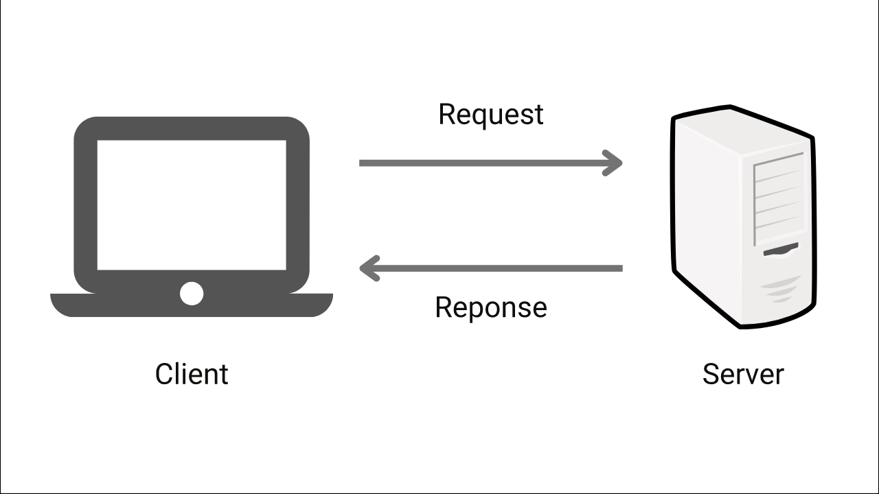
Model deployment
Cloud (or client server)
Edge devices
Notes:
https://www.enjoyalgorithms.com/blog/client-server-architecture

Slide 6
Things to consider
Frequency of prediction
Latency
Model complexity
Data retrieval (batch or real time)

Slide 7


Flask
Popular web framework.
Rapid development and deployment.
Used for developing web applications and APIs
Alternatives: FastAPI, Django

Slide 8
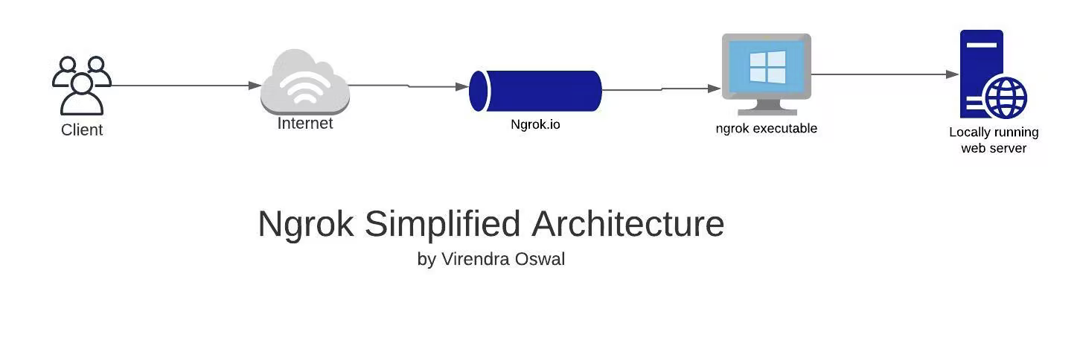
Ngrok
Exposes localhost to internet.
https://07dc-206-176-2-32.ngrok.io:5000/predict
Localhost:5000

Slide 9
Streamlit
Framework for creating web applications.
Quickly prototype ML solutions.

Slide 10
DEMO

Slide 11
References
https://www.enjoyalgorithms.com/blog/client-server-architecture
https://virendraoswal.com/ngrok-localhost-anywhere
https://nearlearn.com/blog/machine-learning-data-science-life-cycle-whats-the-difference/

